Slide 3
AI & Cyber - ADR approach
Rome, 10/11/2023

Slide 4
Agenda
CYBER THREAT LANDSCAPE AND NEW TECHNOLOGIES
AI – RISKS AND OPPORTUNITIES IN CYBER SECURITY
THE IMPORTANCE OF CYBER AWARENESS AND ADR APPROACH
NEW TRENDS ON CYBER AWARENESS

Slide 5
Most recent trend on cyberattacks…
Number of global severe cyber attacks
(‘18 – ‘22)
Perimetro Globale
Number of Cyber attacks in Italy
Attacks are increasing and becoming more impactful
It increases not only the volume but also the amount of damage suffered by victims.
17%
«Critical» Impact
46%
«Major»Impact
«Medium» Impact
37%
By next years, attacks with severe or very severe impacts a significant percentage
Source: Clusit - 2023 Report on ICT Security in Italy
Source: Clusit - 2023 Report on ICT Security in Italy

Slide 6
…also for Civil Aviation
Main cyber threats for Aviation
Type of major cyber attacks suffered by airport operators in Q3/2023*
Ransomware remains one of the most persistent and impactfull threat
Phishing remains actual and has increased sophisticated variants and techniques
DDoS attacks are rising, often launched by hacktivists / Nation State actors highlight the evolving threat landscape for this critical sector.
Cyber espionage is persistent. This troubling trend highlights the potential impact these attacks can have on national security and critical services.
In these days…
Some Italian airports have been targeted by cyber attacks (mainly DDoS) perpetrated by actors with political reason linked to Israelian-Palestinian conflict
*Fonte: EUROCONTROL EATM-CERT - 3rd Quarter 2023 Cyber Threat Landscape & Activity Report for Senior Management

Slide 7
The evolution of the cyber threat evolves with the advent of new technologies...
Cloud
Blockchain
Data storage capacity continues to grow, and the adoption of cloud-based services is increasing. Among the main benefits of this model is cost efficiency, scalability and flexibility.
This new technology will allow distributed sharing of information without the need for a central control and verification entity.
By using the features of a computer network of nodes the blockchain allows you to update the information uniquely and securely. Its use could improve the management and traceability of access, suppliers, passenger data and airport operations.
Internet of Things (IoT)
Robotics
IoT is based on the idea of "intelligent" interconnected objects to exchange the information held, collected and/or processed. Some of its uses in the airport sector can be: predictive maintenance through sensors, air traffic and runway management and weather forecasts.
The field of robotics ranges from the simplest domestic assistant to huge industrial plants.
Today robots perform specific tasks, automatically reproducing and streamlining human work. Its uses can be many: passenger service robots, cleaning and maintenance robots, safety and monitoring (e.g. through the use of drones).
Edge computing
Virtual and augmented reality
The growing need for processing power will lead to increased adoption of edge computing architectures, which can provide lower latency and higher performance. In airport facilities this type of technology can facilitate real-time traffic, surveillance and security data analysis.
Immersive technologies delivering interactive digital experiences. They differ in their field and scope of use (e.g. through VR glasses, devices, or monitors), effectively creating a digital world. Today VR and AR are used for personnel training (flight and ground), for passenger orientation and also for entertainment.

Slide 8
…in particular with the current trend: AI systems.
AI has become a buzzword in the tech industry, but what is it really? AI is a way to make machines "smart" by teaching them to learn and adapt based on data.
This technology has a vast array of applications, including aviation - where it adds an exciting new dimension to cybersecurity.
The integration of AI into aviation operations has the potential to revolutionize the industry, with applications in everything from maintenance and logistics to improving flight safety.
Potential Benefits of AI in Aviation
AI can enable pilots to make faster, more informed decisions and better ensure passenger safety. It also has the potential to optimize flight routes and minimize fuel use and introduce more efficiency on how airports plan infrastructure occupancy and turn-around
Key Challenges and Concerns in Implementing AI in Aviation
Despite the potential benefits, there are still significant challenges to implementing AI in aviation, including data privacy concerns and the need to ensure that AI systems are trustworthy and secured against unauthorized access and cyber threats.
Security and detection
Baggage handling systems
Air traffic management
Passenger assistance
Resource management
Land traffic management
Operations management
Aircraft and runway maintenance

Slide 9
AI promises to revolutionize several sectors, as the main analysts highlight
In 2023, the impact of artificial intelligence (AI) is showing that this technology has enormous potential to transform the economy and transport sector.
Some data
The size of the global AI market amounted to $136.55 billion in 2022, and a compound annual growth rate (CAGR) of 37.3% is expected from 2023 to 2030.
Grandviewresearch Report - Artificial Intelligence Market Size, Share & Trends Analysis Report By Solution, By Technology (Deep Learning, Machine Learning), By End-use, By Region, And Segment Forecasts, 2023 - 2030
It is estimated that the size of the aviation AI market will grow at a CAGR rate of 43.13% between 2022 and 2027. The market size is expected to increase by 3,642.91 million dollars.
Technavio Report - Artificial Intelligence (AI) in Aviation Market Analysis North America,Europe,APAC,South America,Middle East and Africa - US,China,Germany,UK,France - Size and Forecast 2023-2027
Investments in artificial intelligence made in the aviation sector are growing.
In the next few year AI will have a significant impact on significant processes for airport operations
Notes:
Artificial Intelligence (AI) in Aviation Market Analysis - US,China,Germany,UK,France - Size and Forecast 2023-2027 (technavio.com)

Slide 10
In cyber security, AI offers opportunities but also involves risks
The use of AI can bring opportunities and benefits, but also numerous risks and ethical dilemmas.
In addition to being itself a technology subject to cyber threat*, AI can be used by attackers to perpetrate attacks with greater ease.
OPPORTUNITIES
RISKS
Predictive analysis of potential threats (Threat Detection and Prevention). Artificial intelligence can analyze the behavior of network and users to detect unusual patterns or deviations from the norm, which could indicate a cyber attack.
SIEM & SOC Automation - Increased efficiency in managing security events and automated management of certain incident patterns
UEBA Solution (User and Entity Behavior Analytics) to provide enhanced protection for users and assets
…
Create accurate and targeted phishing campaigns (no longer the usual email with misspellings)
Creation and access to portions of malicious code even by attackers with low technical proficiency, that can also self-evolve to avoid defenses
Automated attacks - AI can be used to perpetrate, automatically - brute force attacks, password guessing, Ddos, etc
Social engineering
*ENISA and artificial intelligence - Multilayer Framework for Good Cybersecurity Practices for AI, where good cybersecurity practices are presented to build reliability in the activities of using artificial intelligence.

Slide 11
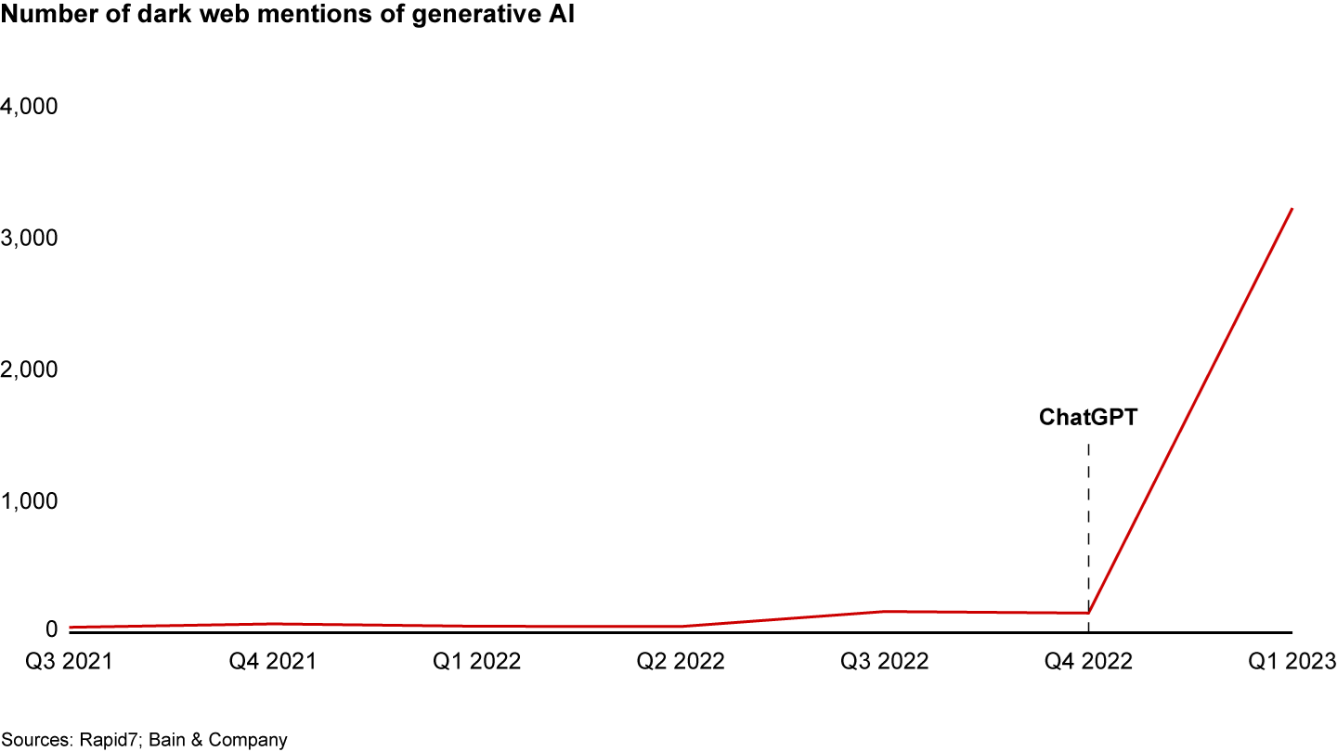
For example, the number of dark web mention of “generative AI” has blown up
The graph shows that the use of generative AI for nefarious purposes has become an increasingly popular topic on the dark web after the launch of ChatGPT.
This shows an increasing interest of malicious actors to AI for malicious purposes.
WormGPT
Main malicious uses of AI
Fake News: AI-Generated and Manipulated Audio, Pictures and Videos
Improving Social Engineering
Malware development and auto/learning functions.
Customized Spear-Phishing at Scale
The use of generative AI will likely enable cybercriminals to launch attacks against thousands of users with customized messages gleaned from data from social media accounts, OSINT sources, and online databases, dramatically increasing the threat to employees from email phishing.

Slide 12
The Role of Training and Education
Aviation organizations must prioritize cybersecurity measures to safeguard their systems and data. This includes implementing robust security protocols, conducting regular cyber risk assessments, and staying abreast of evolving cyber threats.
Additionally, fostering a culture of cybersecurity awareness and providing ongoing training to employees is essential in mitigating the risk
1. Importance of Training in AI and Cybersecurity
As AI becomes more integrated into aviation, it's important for everyone from pilots to ground crews and operators to have a basic understanding of how to work with these systems.
Furthermore, cybersecurity professionals must be trained in the latest AI security best practises.
2. Ensuring Education for AI Professionals
The growing use of AI presents opportunities for those interested in working in this field.
Education and training programs must be designed to ensure that students leaving these programs are equipped with the necessary skills and knowledge to succeed in this rapidly evolving industry.
3. Collaborations Between Educational Institutions and Industry Players
Given the complexity of this field, collaborations between educational institutions and industry players are essential. Industry partners can provide the practical expertise needed to develop effective aviation cybersecurity training programs that prepare students for real-world challenges.
Notes:
The integration of AI presents unique challenges in aviation. As AI becomes more prevalent, concerns arise regarding data breaches and AI-driven threats. Continuous vigilance and adaptability are crucial to stay ahead of these emerging risks.

Slide 13
Awareness on Innovation is crucial, ADR has developed ad ad-hoc program
In ADR, "Innovation Engagement" is a program designed to spread the culture of innovation within ADR
Objectives
To implement an entrepreneurship pathway for our ADR colleagues in order to make them concretely part of the business innovation process
Develop a path to make innovation pervasive in corporate veins through the involvement of ADR colleagues and the Innovation Cabin Crew.
Contribute to the ability to identify Innovation Needs in order to integrate/enrich the Innovative Project Portfolio
Program’s Pillars
FUNDAMENTAL EDUCATION & ENGAGEMENT
ADVANCED EDUCATION &
AWARENESS
PROFICIENCY EDUCATION
ADR GAME
Fundamental Education & Engagement is an all-digital path designed for all ADR resources. The path, which is experiential, is purpose-built and designed to create knowledge and awareness about the open innovation path adopted by ADR.
Innovators Path is dedicated to 300 ADR people and includes 6 Workshops of 6.5h each + 6 Talks of 1.5h each, which will be held in-person at ADR headquarters.
Planned to deliver 3 masterclasses each for 30 people, lasting 12 hrs, aimed at exploring the following topics: Robotics in Aviation, Smart Objects & IoT, Digital Customer EXP.
All participants will be invited in a challenge, in teams captained by CCIs, challenging each other in a 4-round gaming path through an individual quiz that will investigate in level of preparation and skills in Innovation.

Slide 14
In this context, awareness on cyber risks is even more crucial
Although technological measures are needed and the basis to mitigate risks, statistics show that they are not enough, as most cyberattacks happens due to the human factor
Global statistics
74% of all intrusions include the human element through credential theft, phishing, and vulnerability exploitation.
Source: Data Breach Investigation Report (DBIR 2023)
Social Engineering attacks are ranked Top 3 leading cyber threats according to ENISA Threat Landscape 2023 Report
Source: ENISA Threat Landscape 2023 Report
Protecting themself is not only a technological matter, but more importantly it is a matter of people's behaviours. Hence actions should be focused on Cyber Awareness

Slide 15
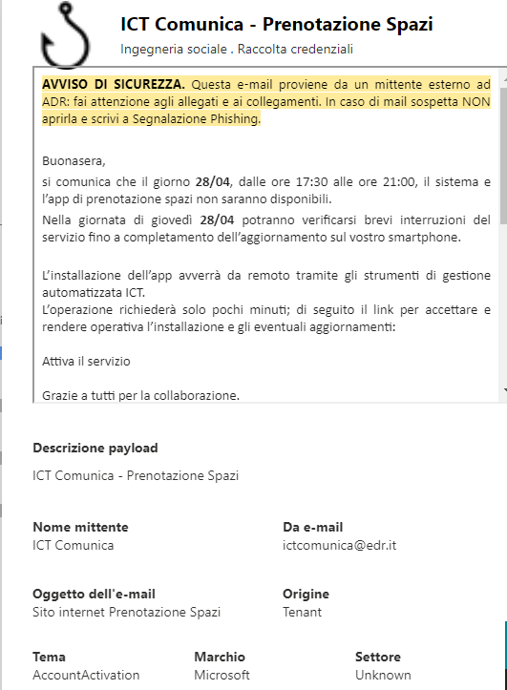
ADR’s approach to Cyber Awareness
ADR’s Cybersecurity Awareness and Training program aims to keep employees' attention on the most significant threats - such as Phishing – , provide basic training to all users on key concepts and promote specific training initiatives for technical or more at risk personnel.
Program initatives
Main drivers of the program
Basic cybersecurity course for all employees
Advanced cybersecurity course for technical personnel and suppliers
Training on basic concepts of Cybersecurity
- Phishing
- Safe surfing
Technical Cybersecurity Training
- Regulations
Cyber threats for airports
Attack techniques
Countermeasures
A. Always keep the attention of all users high
B. Provide basic training for all users
+2300 hours
+160 Trained
Simulated Phishing Campaigns
Classroom courses
Phishing Campaigns Quarterly Simulation
Classroom training for specific areas
OT Security
ICT Business Continuity
C. Provide specialized training for technical and risk personnel (e.g. Admin)
+6.000 email sent
8 onsite classes
Phishing report email box with individual user feedback
E-mail box where users can report suspected phishing cases and find a response to their doubts
E-learning

Slide 16
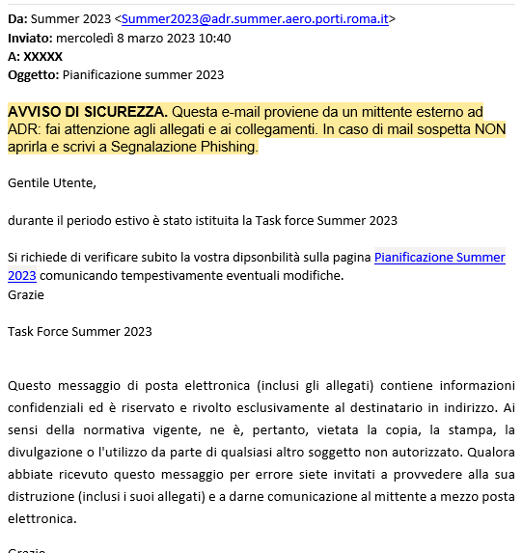
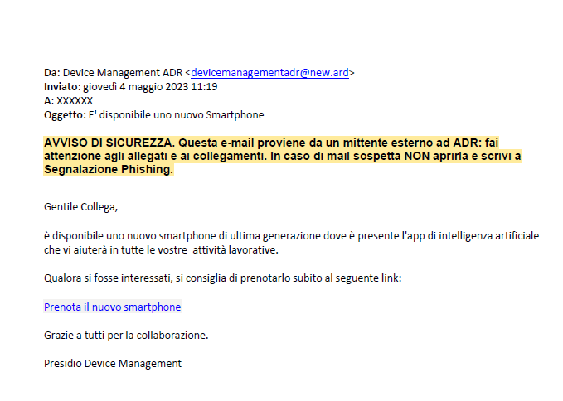
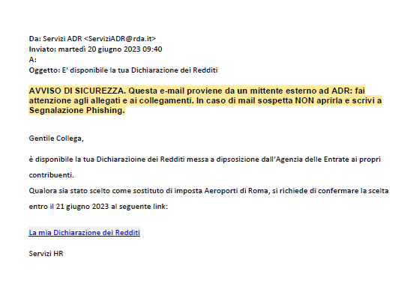
Focus on last year’s Phishing campaigns
Completed
March 2023
Completed
May 2023
Completed
June 2023
Completed
October 2023
Anti-Phishing Program
Mgmt
Phishing
#1
Phishing
#2
Phishing
#3
Phishing
#4
Tax Declaration (Dichiarazione dei Redditi)
Summer 2023
New Smartphone
New Company Bonus!

Slide 17
The program is «alive» and is continuously fed and updated in line with the external context
Initiatives for the continuous improvement of the programme
Key drivers for continuous program evolution and improvement
Specific awareness communications For example in connection with specific attacks or campaigns of Phishing and QRishing
Reports alerts by Information Sharing Authorities and Bodies
Particular threats trends observed by ADR
Threat trends given by the external context
User feedback (given directly or by taking part to courses)
Updating e-learning courses To increase effectiveness and engagement and update content in line with the current threat environment
Classroom training
To address more complex issues - such as OT Security - where targeted learning is needed
Exercises and simulations
To prepare to handle crises and complex events that can originate from cyber attacks against ADR
Focus next slide

Slide 18
Focus on ADR exercise 1/2
Exercise scope and objectives
The cyber exercise aims to test cybersecurity incident management procedures in a simulated cyber incident scenario. Specifically, the exercise aims to identify areas for improvement and allow participants to face the challenge of a cyber incident in a secure and controlled environment.
Exercise Scenario description
The scenario involved the deployment of a ransomware on the Skyway (Fids) system, which would have an impact on airport monitors for displaying flight information.
This allowed participants to deal with a very similar scenario to that of a real cyber security incident (for example, the cyber attack at Bristol Airport in the UK).
Cyber exercise was performed on September 28, 2022
Cyber exercise coordinator & facilitator

Slide 19
Focus on ADR exercise 2/2
Summary of main milestones of Cyber Exercise
Participants & working tables
14:50
The exercise was announced
The exercise started with the formal communication made by Leonardo's Exercise Conductor to the “Capo Scalo”.
The Technical Table was opened to handle the incident.
The Crisis Management Table was opened with the objective of defining the actions to take
The exercise was formally closed with a formal communication from the Exercise Conductor on the closure of the Cyber Exercise session.
Crisis Team
15:03
15:13
Technical WAR ROOM (“Tavolo Tecnico”)
APOC ROOM
(“Sala Apoc”)
15:26
Three different exercise working tables was involved in order to simulate real-case response to cyber incident escalating to a crisis
Coordination across teams was tested and trained
17:22

Slide 20
New frontiers of Cyber Awareness & education
Gamified Cyber Awareness
Gamification is the use of elements and principles of play in order to engage, motivate, train, and make aware.
In the field of Cyber Awareness & Training, this approach is used to make training content in cybersecurity more interactive and engaging for the user. Examples are company reward challenges (escape room, cyber palace, etc.) and adventure games adapted for cyber awareness purposes
Examples of gamified cyber awareness paths*
Adventure game & Escape Room
Video Games
*Vendor publicly available demo websites

Slide 21
…in conclusion
After significant investments in:
Technological solutions for the defense of users and corporate logical perimeter
Complex and articulated Cyber Security Training & Awareness programs
Cyber incident monitoring and response structures and technologies
for 3,99 €…
… on Amazon…

